Slide 1
Resume Parser
Syed Hani Haider, Dinesh Sai Pappuru, Nikitha Kanaparthi
Group Project 9

Slide 2
Motivation
Motivation
To make the recruiting process easier and efficient.
NLP for resume screening: Extracting relevant text from resumes using statistical and machine learning models.
Managing high volume: Efficiently sorting through millions of applications with machine learning algorithms.
Enhancing accuracy: Using machine learning classifiers to calculate accuracy and performance in resume screening.
Kaggle resume dataset:
962 rows
24 categories
Notes:
Resume screening using NLP: NLP enables the system to find and extract relevant text from resumes based on English dictionary, combining statistical, machine learning, and deep learning models of human language with computational linguistics-based rule-based modeling.
Managing high volume of applications: With millions of applications received, sorting through them manually can be time-consuming. Machine learning algorithms can provide a more efficient and accurate way of understanding and fulfilling industry requirements in the resume screening process.
Enhancing accuracy and performance: The proposed system takes a CSV file as input with different categories and resumes, and uses machine learning classifiers to calculate accuracy and performance based on the category and features of the resumes, improving the overall screening process.

Slide 3
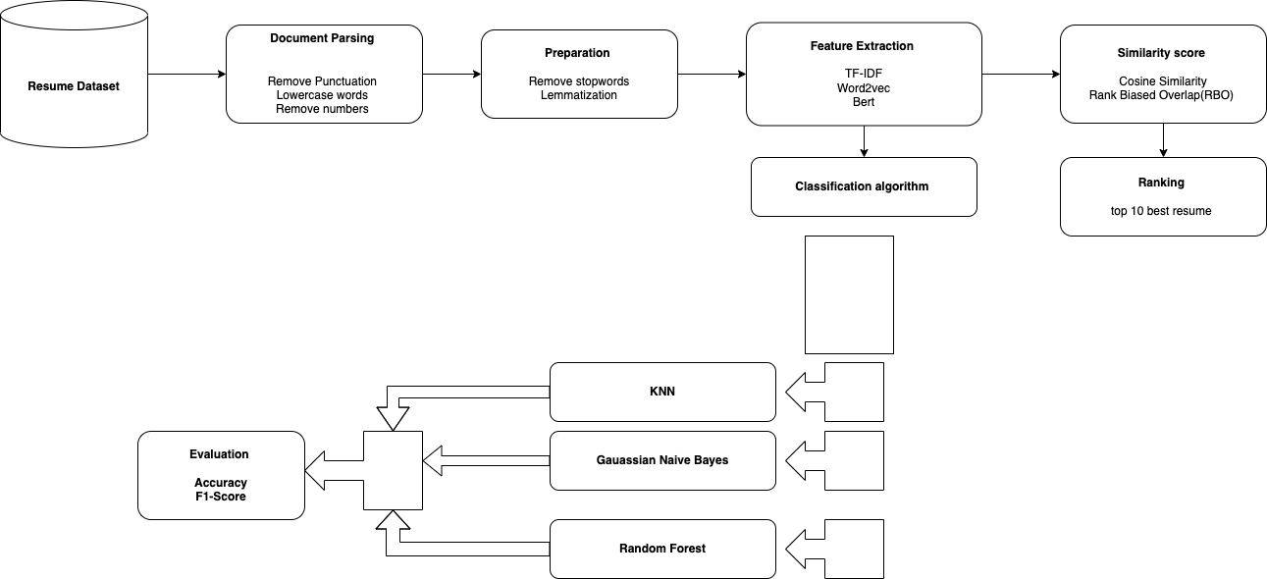
The Approach

Slide 4
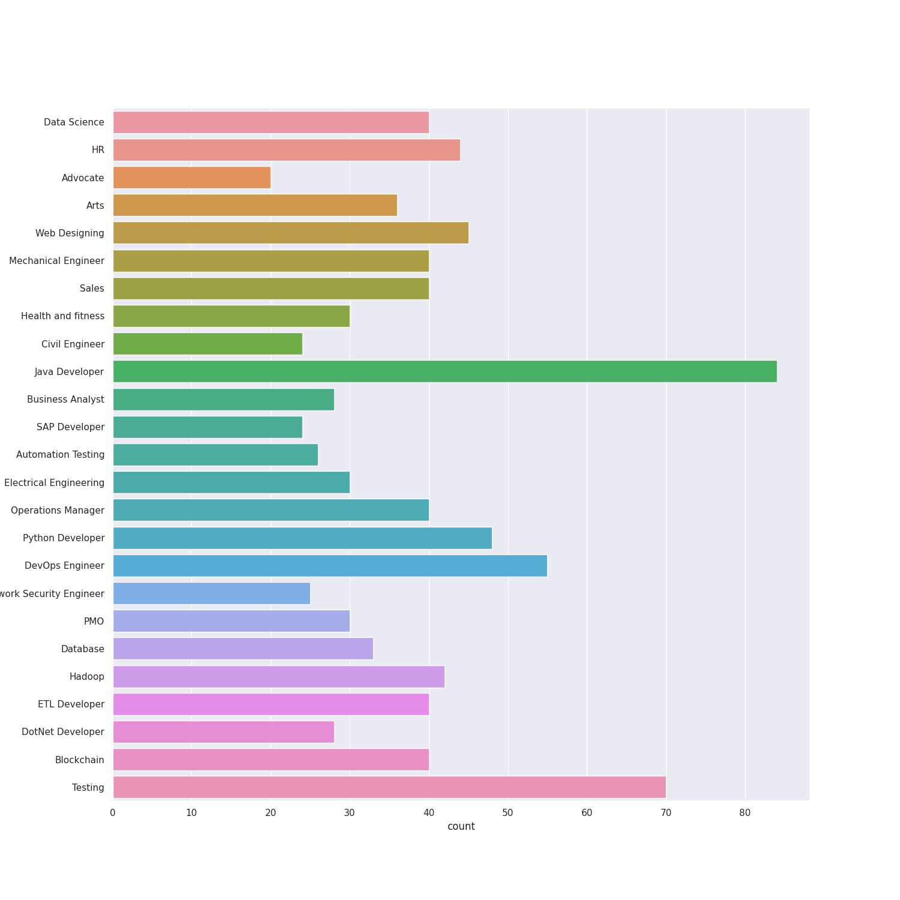
EDA

Slide 5
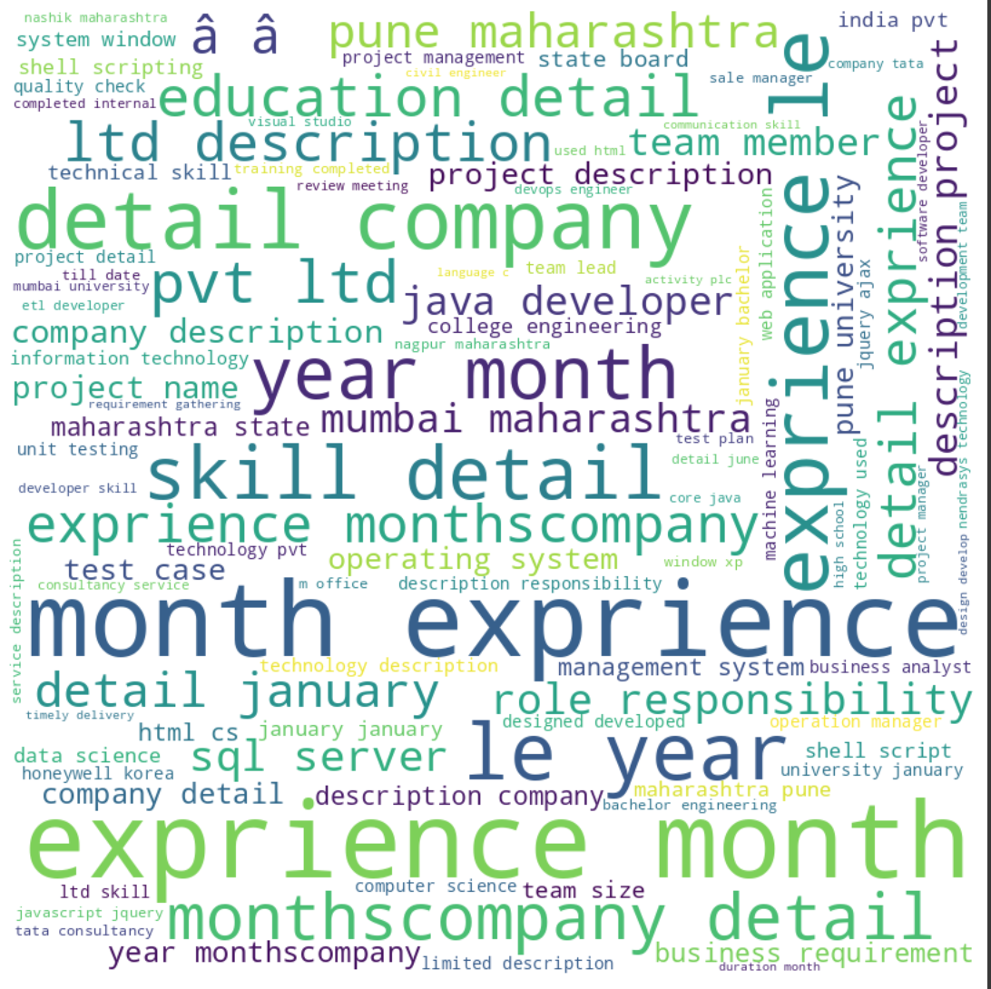
EDA

Slide 6
Embedding techniques
TF-IDF
Assign numerical weights to phrases using term frequency multiplied with inverse document frequency
WORD2VEC
Captures the semantic and syntactic relationships between words by assigning numerical values to words based on their meaning and surrounding words in a given corpus of text.
BERT
State-of-the-art NLP model.
Uses transformer architecture.
Trained on large amounts of data.
Generates contextualized word representations.
Understands word meaning in context.
Notes:
BERT (Bidirectional Encoder Representations from Transformers) is a state-of-the-art natural language processing (NLP) model that uses a transformer architecture and is trained on large amounts of data to generate contextualized word representations, allowing it to understand the meaning of words in the context of the sentences in which they appear.

Slide 7
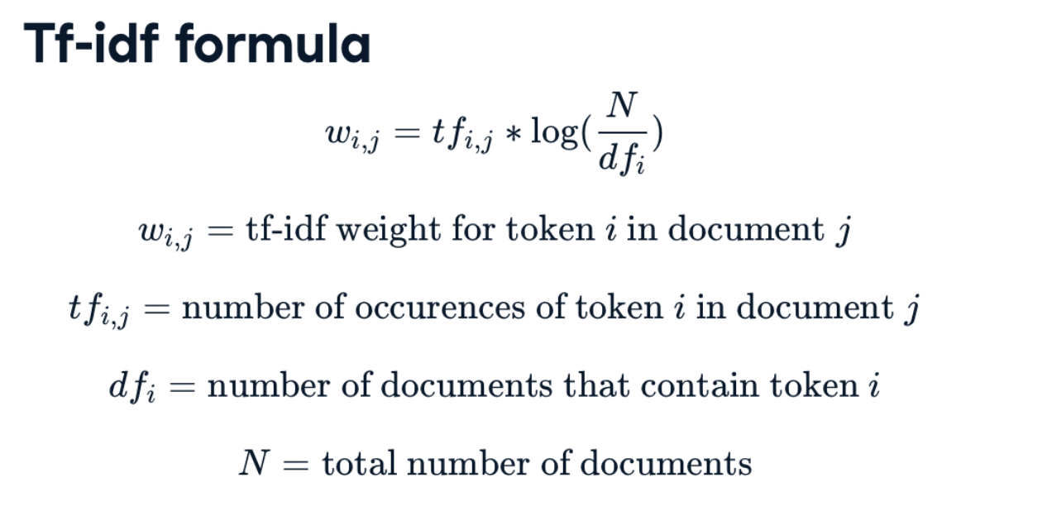
TF-IDF
TF-IDF measures the importance of a word in a document or corpus based on how frequently it appears.
It calculates the term frequency (TF) and inverse document frequency (IDF) of a word to determine its significance.
The TF-IDF score is a product of TF and IDF, and a higher score indicates greater importance of the word to the document.

Slide 8
TF-IDF for resume parser
Using TF-IDF scores of words in both the job description and the resumes, helped identify the resumes that have the highest similarity to the job description. Resumes with higher TF-IDF score for the relevant keywords and phrases ended up more likely to be a good match for the job.
Subjective factors like names, educational institutions were ignored due to which the relevance of resume with the job description was given more priority. Using TF-IDF along with classification algorithms also helped improve the accuracy since the algorithms used TF-IDF vectors as input parameters in prediction.

Slide 9
Word2Vec
Word2vec is a neural network-based approach for generating high-quality vector representations aka embeddings of words based on the distributional properties of language.
Word2Vec generates numerical representations (embeddings) for words based on their semantic and syntactic relationships in a given corpus of text and enables algorithms to better understand the meaning and relationships between words in text data.

Slide 10
Word2Vec for resume parser
Using word2vec for resume classification and shortlisting helped improve accuracy and efficiency by generating high-dimensional vector representations of words that capture semantic and syntactic relationships, which were later used as input features for machine learning models and that in-turn helped improve the machine learning model’s accuracies.
The use of Word2Vec embeddings in combination with Random Forest helped the best to overcome some of the limitations of cosine similarity for the shortlisting aspect. The Random Forest model helped ensure that the Word2Vec embeddings are robust and representative of the resume content, and led to more accurate cosine similarity scores.

Slide 11
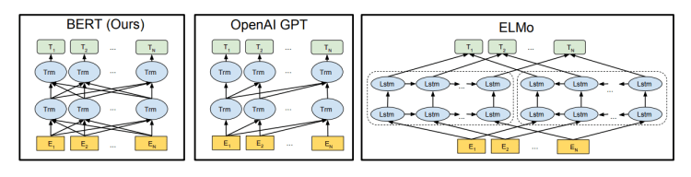
Bert (Bidirectional Encoder Representations from Transformers)
BERT is based on the Transformer model architecture
A Transformer works by performing a small, constant number of steps. In each step, it applies an attention mechanism to understand relationships between all words in a sentence, regardless of their respective position.
BERT is a really powerful language representation model that has been a big milestone in the field of NLP — it has greatly increased our capacity to do transfer learning in NLP; it comes with the great promise to solve a wide variety of NLP tasks.
BERT is bidirectional, meaning it considers both the left and right context of a word during training.

Slide 12
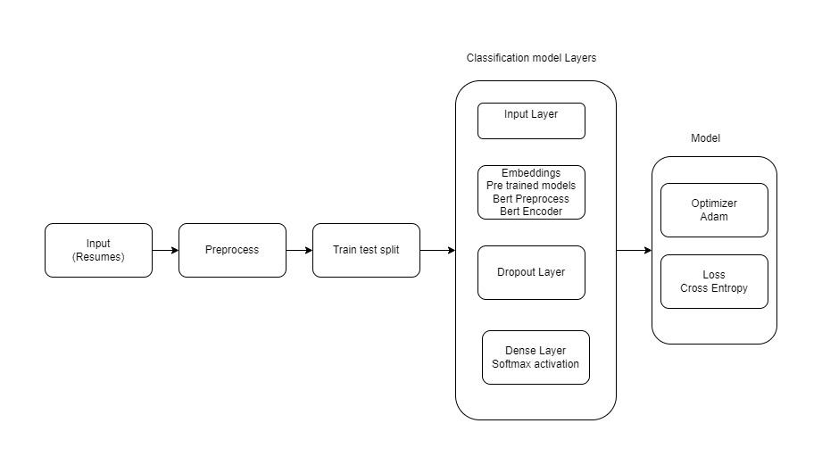
Bert Classification Model

Slide 13
Classification
 | TF-IDF- F1-score | Word2vec- F1-score | Bert
Random Forest | 0.97 | .96 | -
Gaussian Naive Bayes | .97 | .69 | -
KNN | 96 | .93 | -
Accuracy | - | - | 30*
* Work Under progress checking to see how to make it better

Slide 14
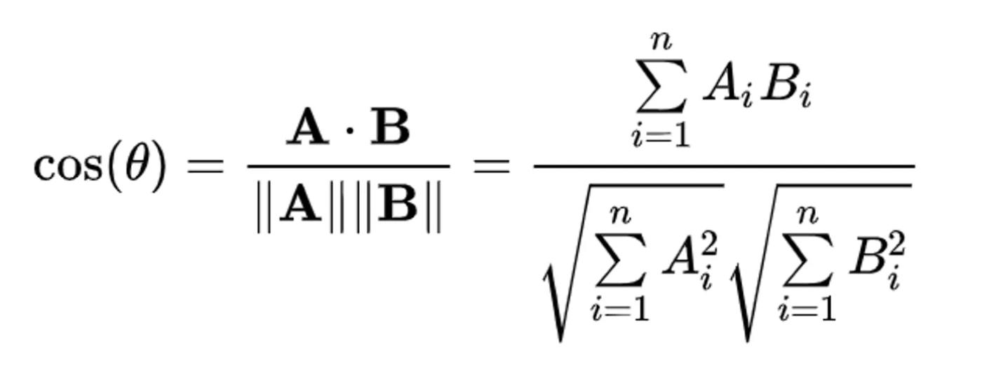
Ranking Resume
Cosine similarity
Definition: Measure of similarity between two vectors using the cosine of the angle between them.
Calculation: Dot product of vectors divided by magnitudes, independent of vector magnitude.
Applications: Widely used in NLP, information retrieval, recommendation systems for tasks like document similarity, text classification, and content recommendation.
RBO (Rank Biased Overlap)
Definition: Similarity measure for ranked lists, e.g., search rankings or recommendation lists.
Incorporates Rank and Similarity: Considers both item similarity and rank positions, giving more weight to top-ranked items.
Flexible and Interpretable: Can be adjusted with a single parameter ("p") to control similarity calculation, making it adaptable for various applications.
Notes:
Cosine similarity is a measure of similarity between two vectors in a multi-dimensional space. It is widely used in various fields, including natural language processing (NLP), information retrieval, and recommendation systems.
Cosine similarity calculates the cosine of the angle between two vectors. The angle between two vectors can be interpreted as the similarity between the vectors, where 0 degrees indicates maximum similarity (cosine value of 1) and 180 degrees indicates minimum similarity (cosine value of -1).
Sure, here are three key points about RBO (Rank Biased Overlap):
Definition: RBO (Rank Biased Overlap) is a similarity measure that quantifies the similarity between two ranked lists, such as search engine rankings or recommendation lists.
Incorporates Rank and Similarity: RBO accounts for both the similarity of items in the lists and their rank positions, taking into consideration the top-ranked items more heavily and penalizing differences in ranks between corresponding items.
Flexible and Interpretable: RBO can be adjusted with a single parameter, known as the "p" parameter, to control the weight of the top-ranked items in the similarity calculation, making it a flexible and interpretable measure that can be used in various applications to measure the agreement between ranked lists.

Slide 15
Cosine Similarity
 | TF-IDF | Word2vec | Bert
AVG Similarity score | 0.24 | 0.35 | 0.87
AVG RBO Score | 0.44 | .43 | .72

Slide 16
Conclusion
Based on the results of our project, it appears that BERT outperforms other techniques (TF-IDF and Word2Vec) when it comes to shortlisting resumes based on job description similarity. On the other hand, for classification purposes, TF-IDF appears to be more effective.
For the future scope we note that the performance of these techniques can vary depending on the dataset and job descriptions used. Therefore, we believe that we can conduct further experimentation and fine tune and find a balance between both techniques that would yields us with the best performance for both shortlisting and classification purposes.

Slide 17
Thank you

Slide 18
Github
https://github.com/hanihaider1/Resume_NLP

